Slide 1
Introduction to Mendeley
Notes:
Welcome to this introductory session on Mendeley. This presentation will cover the basics of what Mendeley is, how it can help to improve your research and writing processes and how you actually use it.

Slide 2
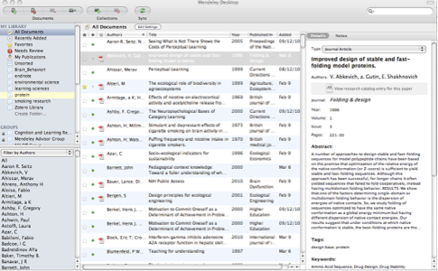
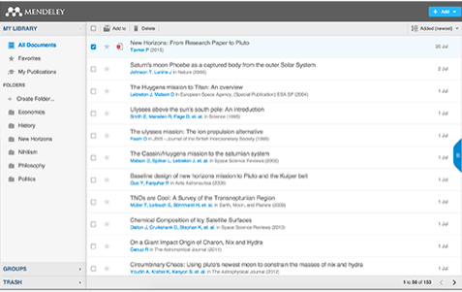
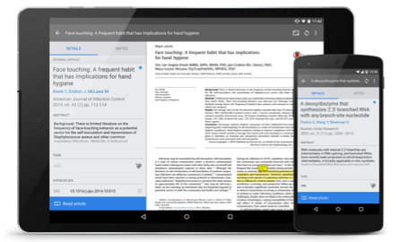
What is Mendeley?
Academic Software
Cross-Platform (Win/Mac/Linux/Mobile)
All Major Browsers
Desktop
Web
Mobile
Notes:
So what is Mendeley? Mendeley is an academic software which is available across a number of different platforms. You can run Mendeley on you’re your mac your pc or even on Linux and in all major browsers. Mendeley offers a desktop application that you can run in your computer a web library for whenever you are not at your computer and a mobile application so you can work on the go
We’ll see how the desktop and web components work together in the next couple of slides.

Slide 3
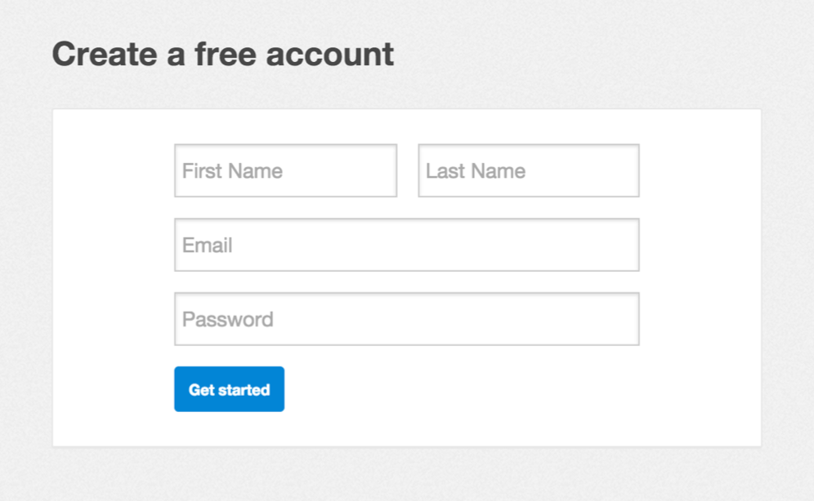
Getting started
Notes:
The first thing you’ll need to do is to create an account via mendeley.com. This is completely free to do and only takes a few seconds. You’ll need a Mendeley account to log into the different versions of the software.
Once you’ve created your account you’ll be prompted to download the appropriate version of Mendeley Desktop for your current machine. You don’t have to do this right away, but it’s a good idea to have the desktop application installed on your main working computer. Once you have done that you can start benefiting from all that Mendeley offers.

Slide 4
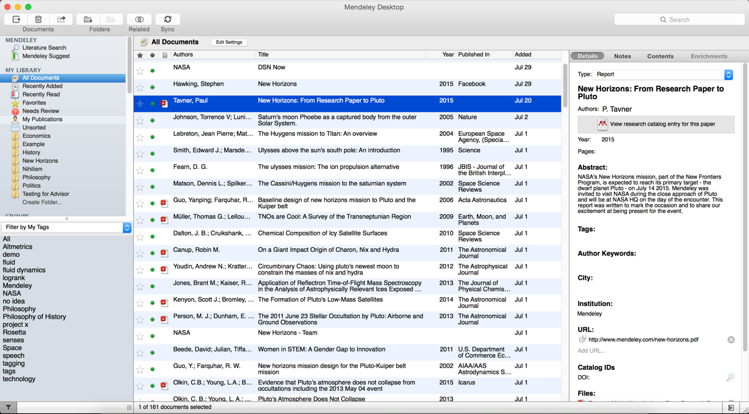
Mendeley Desktop
Notes:
This is what your desktop library looks like.The desktop is divided intro 3 panes, they follow a workflow hierarchy from left to right. Any activity in the left pain affect the display of content in the centre pain, and any activity in the centre pain is reflected on the right hand side, the document details pain.
The left hand pain is you top level library overview. There are a few default folders, these include: All Documents, recently added and read documents, favourites, needs review, my publications and unsorted. You can create your own folders and subfolders. You’ll also see other options here the relates to groups that you have either created of joined. As well as access to Mendeley suggest, where you will find personalised recommendations based on other documents in your library and your interaction with Mendeley and other users. I’ll get to the groups, collaboration and content discovery features in more detail later on in this presentation.
The centre pane shows the references list for whichever folder you have selected in the left hand panel. There are a few functional elements here that I’ll explain shortly.
The right hand side pane is where you’ll see document details related to the references selected in the middle pane. The right hand panel is not only for document details, like title, author, abstract etc.. It is also where you’ll find the document-wide notes, post-it annotations, content tables and other data like embedded figures, tables and figures.

Slide 5
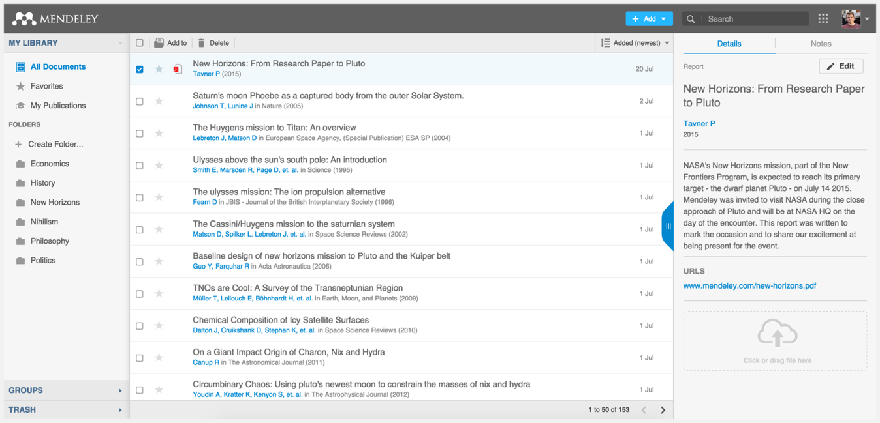
Mendeley Web
Notes:
Mendeley Web is the version of Mendeley accessible via your web browser. You’ll need to be logged into your Mendeley account in order to access it.
The layout is similar to what we’ve just seen for Mendeley Desktop - although it has been optimized for use in a browser. The same three-column structure persists.

Slide 6
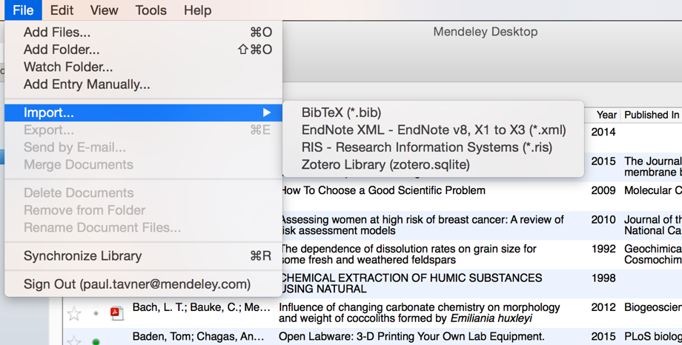
Adding Documents
Select a file or folder to
add from your computer
Import from another reference
manager, or BibTeX
Watch a folder
Add reference by
manually entering details
Notes:
Mendeley makes it easy to add documents. The simplest way is drag and drop the file right into Mendeley. There are actually quite a few ways to add documents to your library besides drag and drop you can use the File menu and select from a few options:
- You can select the file or a folder to add from your computer,
our you can define a watch folder. A watch folder is a folder or multiple folders that you define in your computer to keep an eye on. What this means is what whenever a pdf is added to your folder, Mendeley will automatically know is new and import it for you.
You can also add references manually instead, which allow you to complete a number of fields manually.
If you are already using another reference Manger such as RefWorks, EndNote or Zotero, you can also easily carry across your references to Mendeley easily. Simply export your library from those tools to a standard format sur RIS or BibTeX and you will have no problem importing your library.

Slide 7
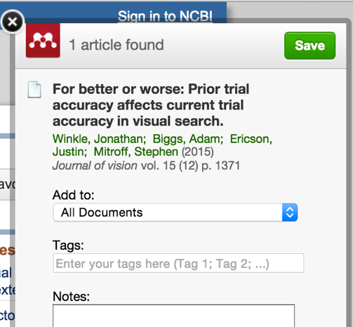
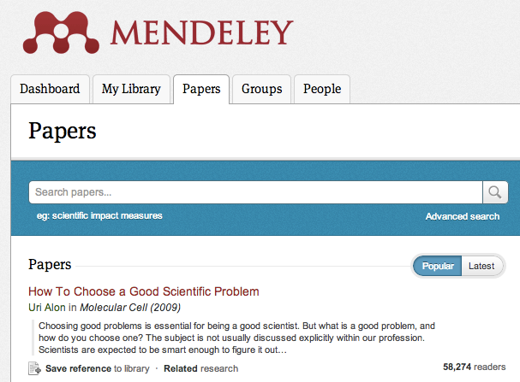
Finding New Research
Mendeley Web Importer
Mendeley Research Catalog
Notes:
There are a few other ways to can add documents to your library, namely The Mendeley Web Importer and The Mendeley Research Catalogue.

Slide 8
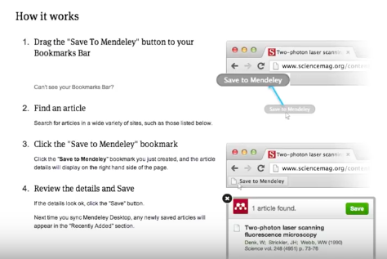
Web Importer
Notes:
The Mendeley Web importer is an invaluable tool when performing literature reviews or searching in databases for articles of interest. If you visit Mendeley.com/import you’ll find the instructions on how to install the bookmarklet into your browser. And also information on all the databases our importer currently supports. That bookmarklet will tell Mendeley everything its need to know to add you article into your library with all the metadata. I’ll show you what it looks like in action

Slide 9
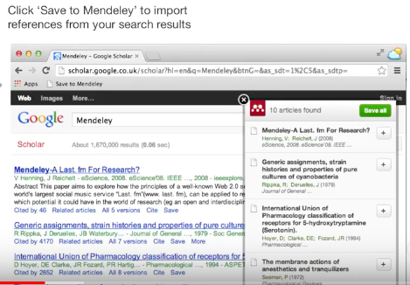
Web Importer
Notes:
Anytime you come across any interesting article online or when you do a search on Google Scholar or one of the many other supported websites you can save this article to your library by clicking the browser bookmark ’save to Mendeley’ a modal window like this one will pop up, then you can select the article you want to import and then click the green button to save it. Done! If you have access to the article via your institutional network a PDF icon will generally indicate that the actual article or file is accessible and it will be then saved automatically to your library along with the metadata reference Metadata
Certain online catalogs, such as ScienceDirect - pictured here - allow you to export references directly to Mendeley. Look out for the Export button on pages like this.
Other catalogs will allow you to export in file formats such as RIS, which can then be added to Mendeley using the File menu.

Slide 10
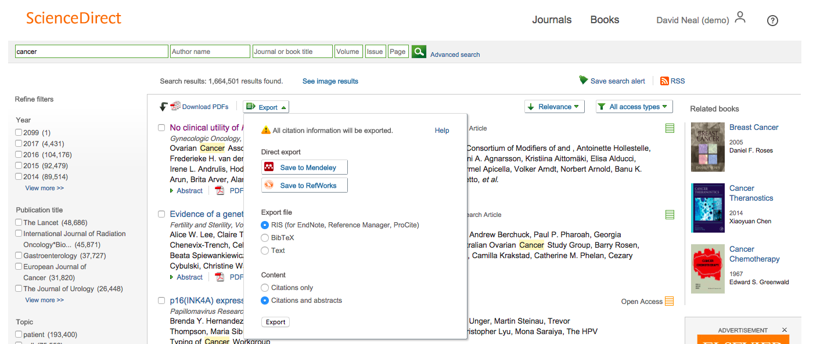
Scopus and Science Direct
Notes:
Mendeley has partnered with Science Direct and Scopus to make importing articles and references into your library even faster.
In Scopus and Science Direct and Scopus, click export to see the save to Mendeley option so you can add an article to your library. Options to Save to Mendeley show up in many other databases, but if an integrated solution like this is not available simply use the web importer to do the trick.

Slide 11
Sync
Notes:
Unlike other Reference Managers, Mendeley securely syncs your library between devices and backs it up online. That means that Mendeley desktop and web update each other so you will always have access to your articles and references even if you are not at your computer. Your library is 100% secure and is not visible to anyone else but syncing does allow Mendeley to analyse your library anonymously so it make personalised suggestions to you on request, this way you can discover other researchers and research in your field and see what articles are more popular right now.

Slide 12
Organize
Managing Your Library
Notes:
Now that you’re familiar with adding references to your library, let’s talk about how you can order and structure your library.

Slide 13
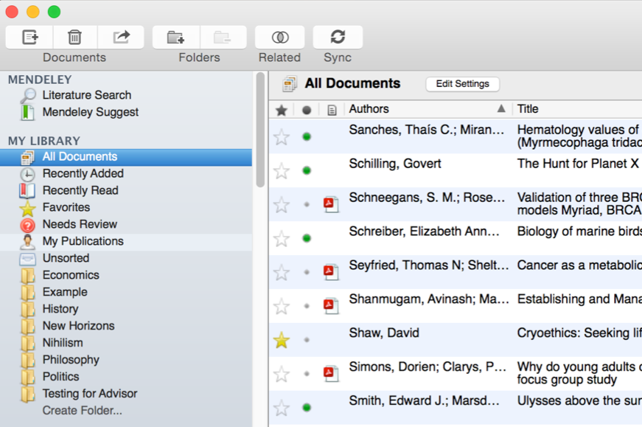
Manage Your Library
Use column
headings
to order your
references
All items in
your personal
library
Items added
in the last two
weeks
Mark entries
read or unread
Access your
recently read
items
Entries with
attached PDFs
can be opened
with the PDF
Reader
All items you’ve
starred in your
library
Items in need
of review
Star items to
mark them as
favorites
Notes:
Mendeley Desktop’s interface should be fairly intuitive if you’re familiar with programs like iTunes, or even Gmail. The left-hand panel offers a number of different options to help filter your document list to exactly what you need to find.
The default position when opening Mendeley Desktop is ‘All Documents,’ which will list all items in your library. You can use the column headings (such as Author Names, Year, etc.) to order your documents by that value - this can be useful for finding works by a specific author, for example.
When you add materials to your library, they will initially be marked as unread - indicated by a large green dot in the second column. You can toggle this off and on by clicking it. Alternatively, a document will be marked as read once you’ve spent a certain amount of time reading it in the Mendeley PDF reader.
You can ‘star’ documents to mark them as favorites. They can then be easily retrieved via the left-hand panel.
You can also use the left-hand panel to access items you’ve recently added, or items you’ve recently read.

Slide 14
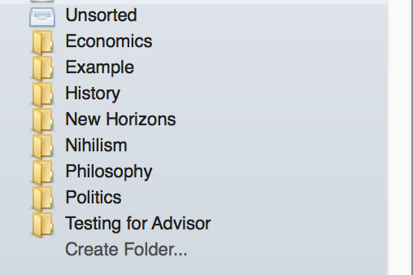
Create and Use Folders
References not added to a folder
will appear in ‘unsorted’
Your folders will be listed below.
Drag and drop to re-order them.
Use ‘Create Folder’ to enter a
new folder name.
Notes:
Folders allow you to quickly file your references under different topic headings. You can drag and drop references from your library onto the folder name in the left panel to add that reference to a folder.
You can also create folders within existing folders.

Slide 15
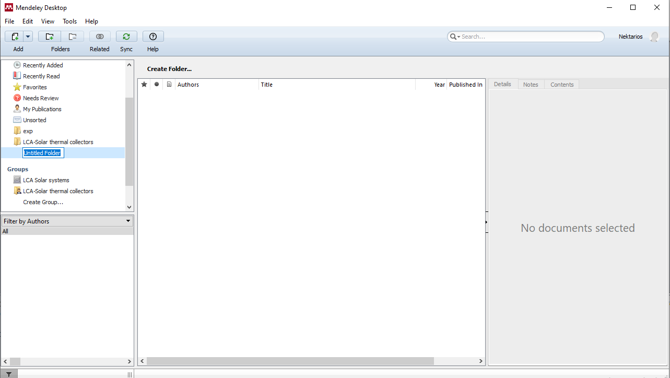

Slide 16
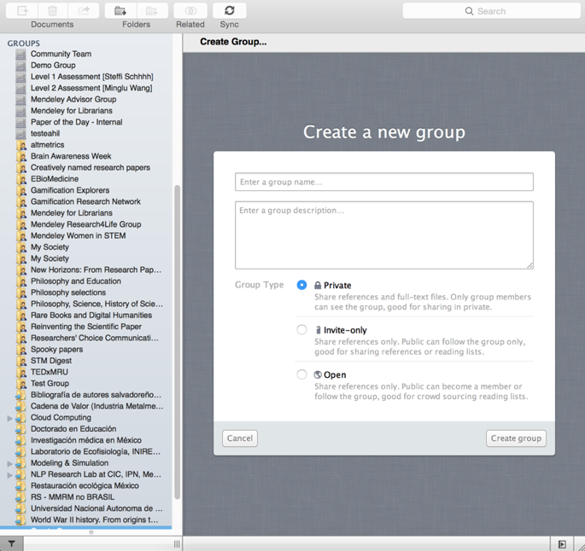
Create Groups
See the groups you created, joined or follow.
Add documents to a group by dragging and dropping.
Notes:
Mendeley groups allow you to come together with other users and to share resources. If you’ve already created or joined groups, you’ll see them listed in the left panel of Mendeley Desktop - underneath your personal folders. To add materials to a group, just drag and drop them onto the group name.
You can create new groups at any time by using the ‘Create Group…’ option both on Mendeley desktop and online. The process is quick and easy. Mendeley offers three different types of group:
Open - these groups are publicly visible and accessible to anyone. They will be listed in the groups directory on Mendeley’s website. Members can add references to the group - but only the reference details will be added.
Invite-only - these groups are publicly visible, but membership is controlled by the group admins. Anyone can ‘follow’ the group to access the references, but only full members can add or edit references.
Private - these groups are not publicly visible. Members need to be invited. Members can share full-text papers with each other, and can also collaboratively highlight & annotate on these materials.

Slide 17
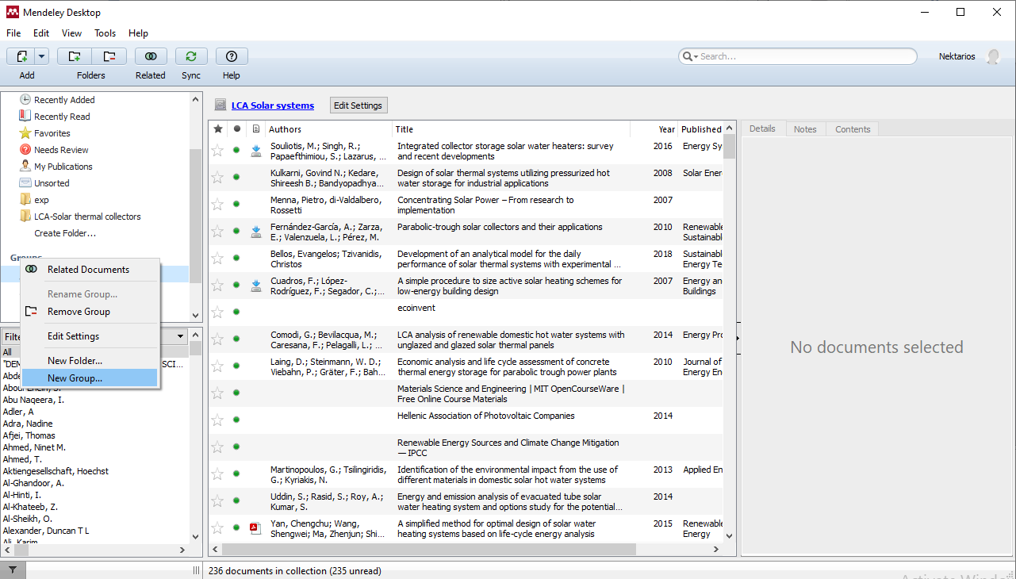

Slide 18
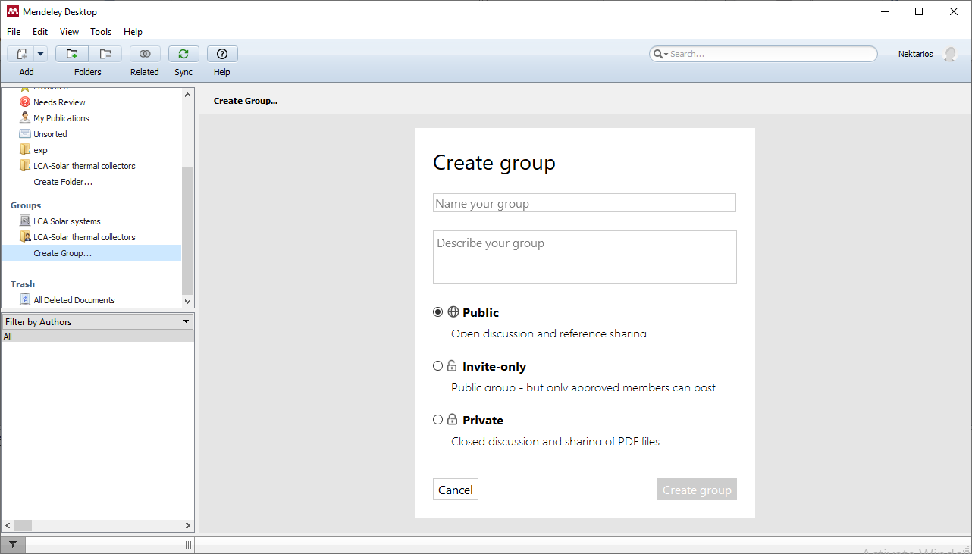

Slide 19
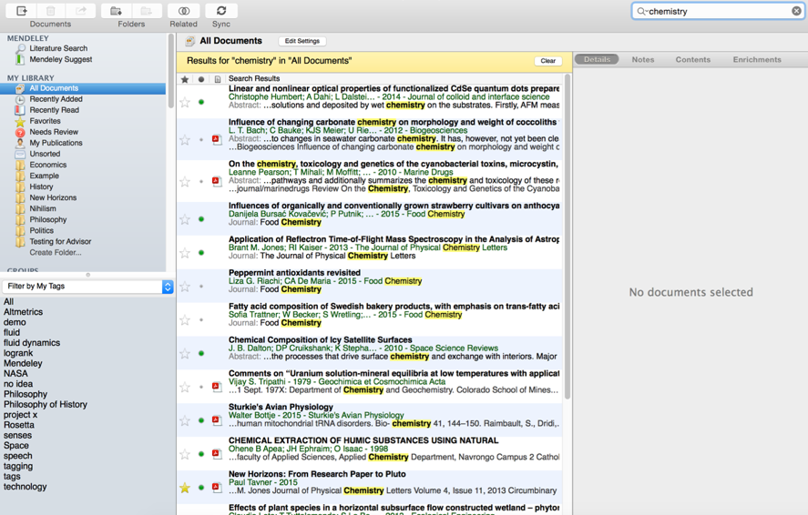
Search Your Documents
Enter your search term
in the search field
The main view will be
filtered accordingly
Click on a specific folder
to search within it
Use the clear button to
remove the search filter
Mendeley’s search tool
will look at reference
metadata, but will also
search within the full text
of PDF papers.
Notes:
Mendeley offers a powerful search tool to help you to locate items in your library. Just enter your search term in the field which appears in the top right corner and Mendeley will filter your current view to show references which contain that term. It will also search within the full text of PDF papers which appear in your library.
The search is context specific, so if you’re not getting the results you expect make sure that you have the appropriate folder selected in the left-hand panel. If in doubt, select ‘All Documents’.
Use the ‘clear’ button which appears on the yellow toolbar to remove the search filter.

Slide 20
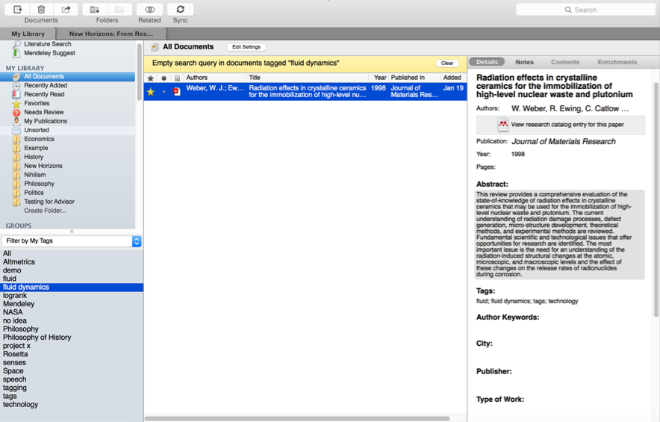
Search Your Documents
Add tags to papers in your
library which share a common
theme
Use the Filter Menu to filter
your library view to only include
tagged items
You can also filter by Author,
Author Keywords and
Publication
Notes:
You can also use tags to help locate a reference or references within your library. You can add multiple tags to your references using the document detail panel when you have the reference selected.
Then use the Filter by My Tags menu which appears in the bottom left corner to quickly pull up materials that you’ve tagged.
The list of available tags will only display tags used in your current folder view - so, again, make sure you are viewing the appropriate folder or All Documents before attempting to filter.

Slide 21
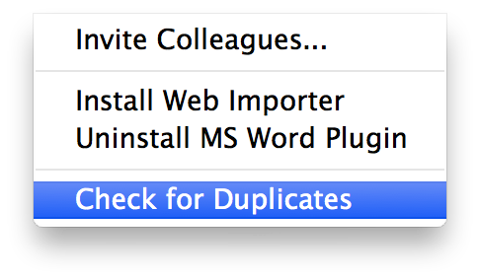
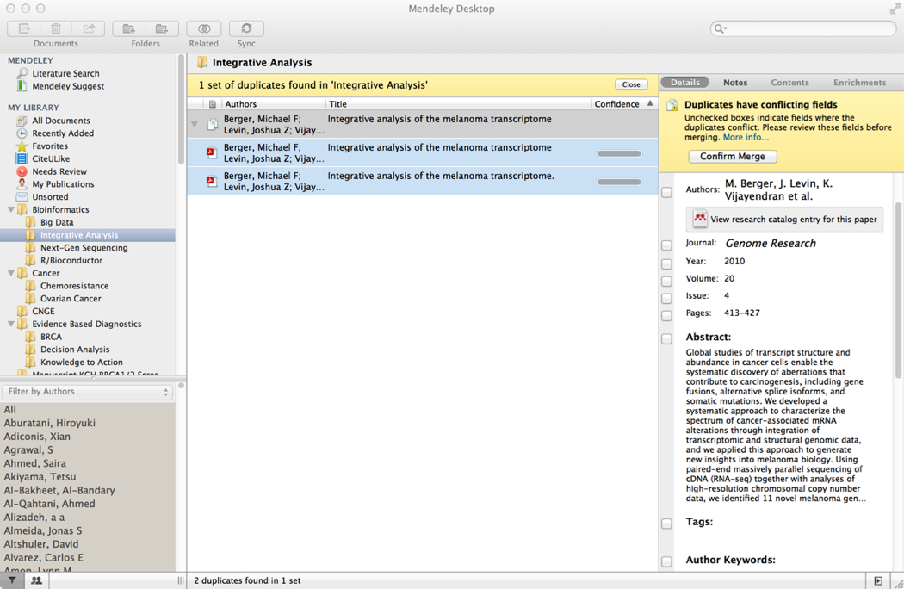
Checking for duplicates
Notes:
As your library keeps growing it is difficult to recall if you have already added a reference to your library or not and inevitably you end up adding the same article to your library twice, sometimes more.
But this is ok in most cases Mendeley recognises the article and keeps only one entry or simple attaches the PDF to the reference if it did not already have a file attached. In other cases you’ll end up having to check up for duplicates.
Use ‘Check for Duplicates’ - found in the Tools menu. Mendeley will identify any duplicate entries and offer to merge these into a single, combined entry. You will be prompted to check over the details of the combined version before the merger is completed - allowing you to take details from each of the entries you’re merging.

Slide 22
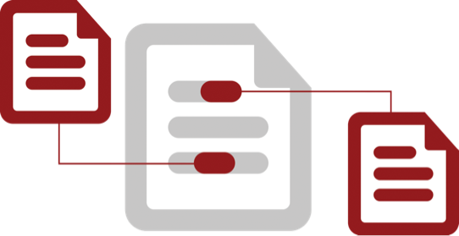
Cite
Using the Mendeley Citation Plug-In
Notes:
We’ve gone through the steps of how to set up your library, organizing your articles and references and using the PDF viewer to read and annotate. It’s about time we get started on writing your own papers.
Mendeley comes with a built-in citation Plug in that will save you time by helping you cite references as you work on your manuscript. No more tedious hours checking citation styles and writing your own bibliographies. Mendeley will do all the work for you. making it ideal for submitting assignments and resubmissions to different journals or publishers.

Slide 23
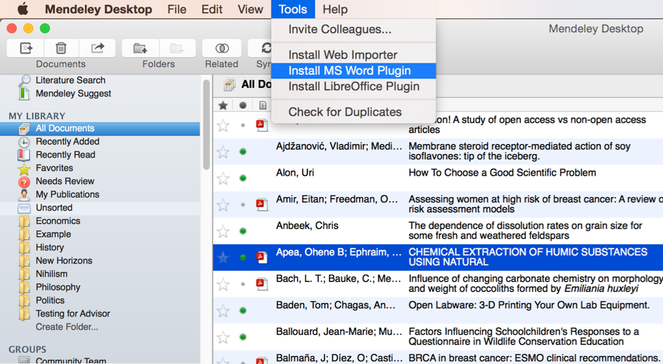
Install the Citation Plug-in
Notes:
You’ll first need to install the citation plugin. This can be done via the Tools menu within Mendeley Desktop.
The citation plugin supports Microsoft Word for windows and Mac and the free alternative LibreOffice for Windows, Mac and Linux. Depending on which of these you have installed, you will see the prompt to install the plugin.
Once installed, the citation plugin will appear within your word processor. Its appearance will vary slightly depending on your operating system, but you will see the same buttons and options in both.
Let’s open the word processor to see the citation plugin in action.

Slide 24
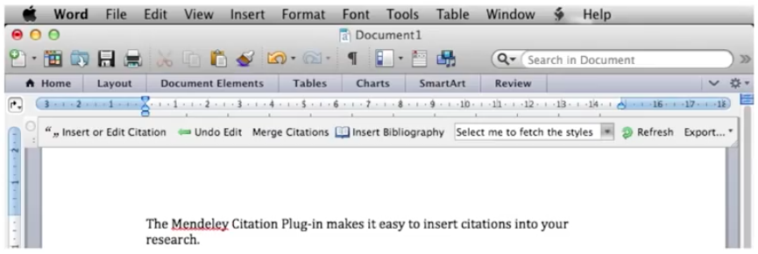
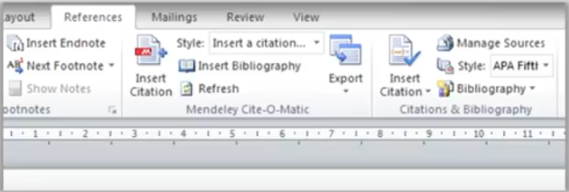
The Citation Tool Bar Appears in Word Automatically
Mac
Windows
Notes:
On a Mac the plugin looks like a bar that lists the functions of Mendeley. You can move this bar wherever you like or you can hide it. If it accidentally disappears, don’t worry go to view then toolbars and click Mendeley Toolbar to make it disappear.
In Windows the plugin looks a little bit different. As you can see below. You can find it under the References tab and the Toolbar is integrated in the Ribbon

Slide 25
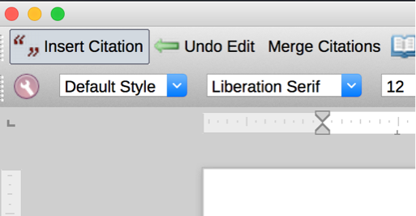
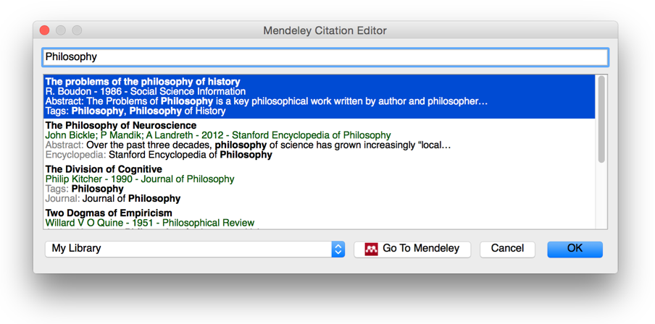
Generate In-Text Citations in Word
Notes:
Inserting a citation is achieved by first positioning your cursor in the appropriate location and pressing the ‘Insert Citation’ button which appears on the Mendeley toolbar. You also need to be running Mendeley Desktop, and will be prompted to start it if it is not currently running.
Pressing the button will open the Mendeley search tool. This box allows you to enter a term - such as an author name - before returning search results from your library. Locate the reference you want to cite, click to select it and press the Ok button. You will see that the citation is added. Its appearance will vary depending on which citation style you currently have active - we’ll talk more about this shortly.
That’s all there is to it - you’ve added your first citation! Congratulations!
If you’re looking for a particular citation and can’t remember its details you can also opt to switch to Mendeley desktop to locate it - using search or filtering by tags, for example. Just press the ‘Go to Mendeley’ button to switch over to that interface.
Once you’ve located the appropriate reference, click to highlight it and press the ‘Cite’ button which temporarily appears on the Mendeley Desktop toolbar. If you want to cancel the citing process and return to your manuscript press the cancel button.
Note that your manuscript is considered locked while this process is active. You need to cancel the citation to return to the document, or insert a citation before you can switch back to your word processor.

Slide 26
Merging Citations
Notes:
As you work through your paper, sometimes you need to add extra citations alongside previously added ones. Most citation styles require you to merge citations if multiple citations apply. Mendeley can handle this for you. Just insert two separate citations, highlight them both in the word processor and press ‘Merge Citations’ to combine them.

Slide 27
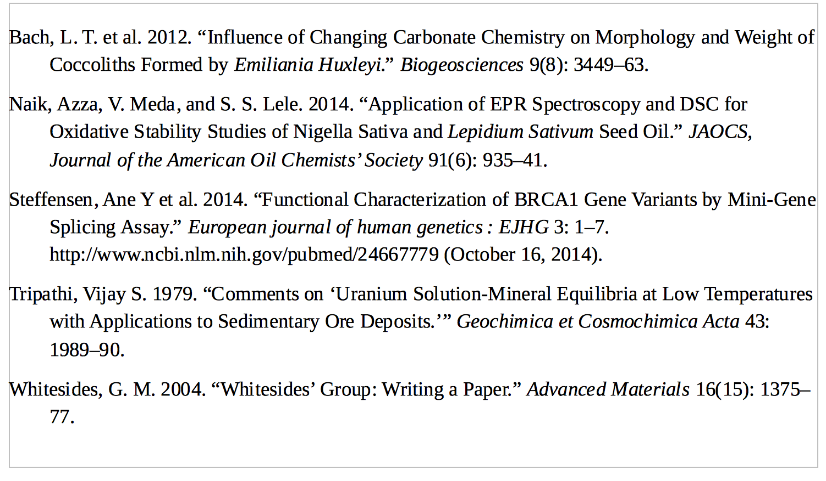
Inserting Your Bibliography
Notes:
Once you’ve done adding citations you’ll need to generate a bibliography. Ensure your cursor is positioned where you want your bibliography to appear and press the ‘Insert Bibliography’ button - it just takes one click!
Mendeley will now look through your manuscript, pick out all the citations you’ve added and order them into a list. The exact ordering and appearance of your bibliography will depend on the citation style - which we’ll talk about next.

Slide 28
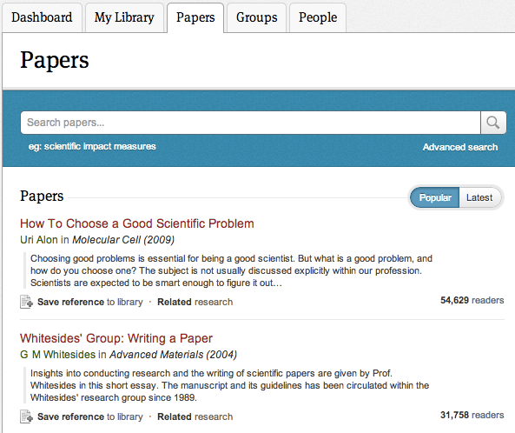
Search the Catalog Online
Conduct advanced searches or browse by discipline
Find new research based on what is popular or the most recently added
Notes:
You can also search the catalog online via mendeley.com’s Papers tab. If you’re logged into your Mendeley account, you’ll be able to save the resulting references straight to your library.

Slide 29
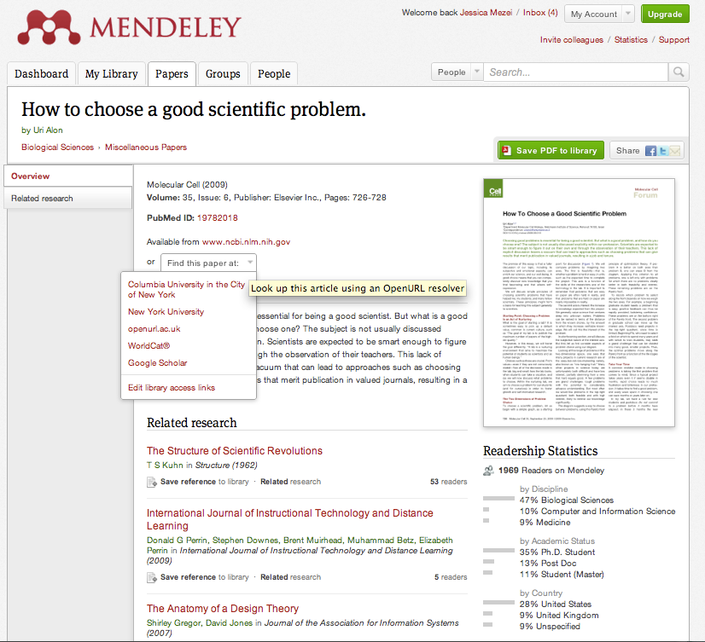
Quickly Add New Research
If the article is freely available, it’s a one-click addition to your library
Or use Open URL to locate the full text
Notes:
When viewing a web catalog entry, you’ll see the option to add the reference to your library with just a single click. If the paper is freely available - ie open access - you’ll also be able to download the full paper.
For other references, you can use the ‘Find this paper at’ dropdown menu to view different options. Using Open URL will allow you to retrieve a paper through your institutional access, providing your institution has the appropriate subscription.

Slide 30
Mendeley
www.mendeley.com
Notes:
We’ve come to the end of this presentation. This was a lot of information to digest, but if you don’t remember it all, don’t worry. You can check out the webinar version of this presentation on Mendeley’s official YouTube channel, where you will also find other videos explaining Mendeley’s features. Thank you for attending this session and we’d like to wish you a warm welcome to Mendeley.

